Slide 1
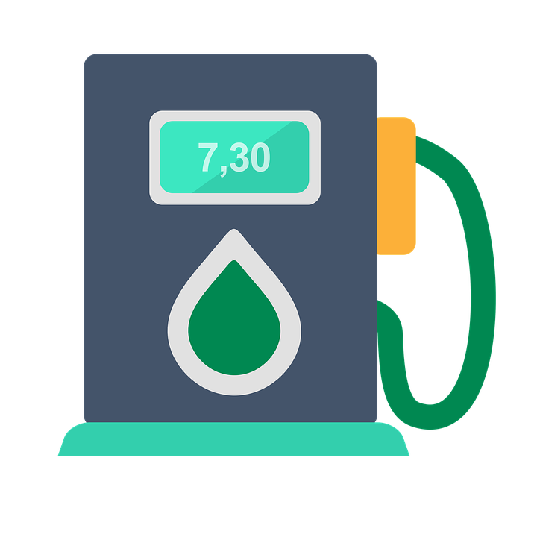
PETRO-BYTES
“ Petrol Fraud Se Azadi, Bolo Azadi ! ”

Slide 2
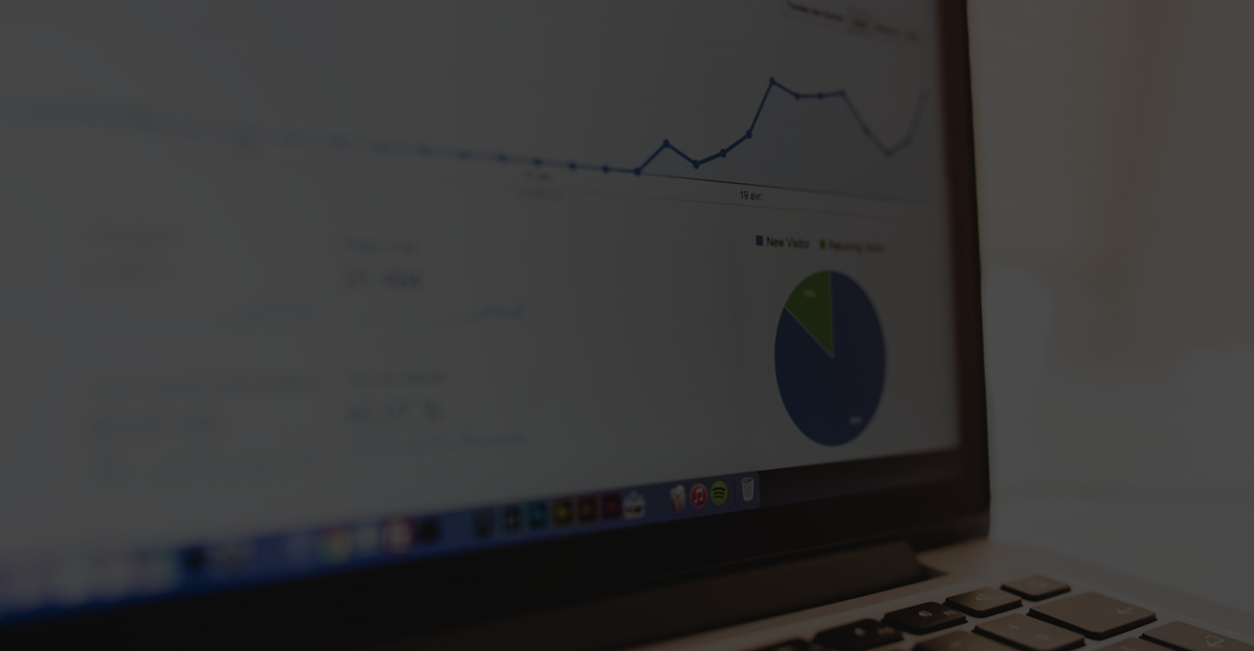
Common Frauds :-
The Employee distracts you from looking at the fuel meter
Disengaging the automated nose before the fuel is filled
Adulterated Petrol
So we thought, Let’s Deploy Some Bytes To Solve This Problem.

Slide 3
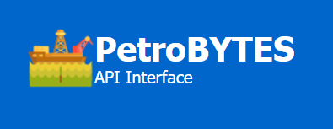
A one Stop solution to prevent you from all sorts of Petrol Scam

Slide 4


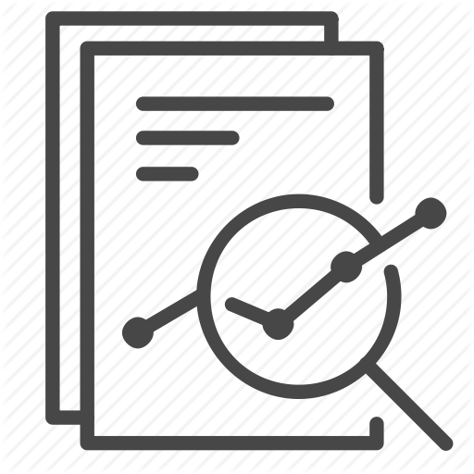


Client
Enters his Requirements
Data Analysis
Administrator
Data Analysis for Users

Slide 5
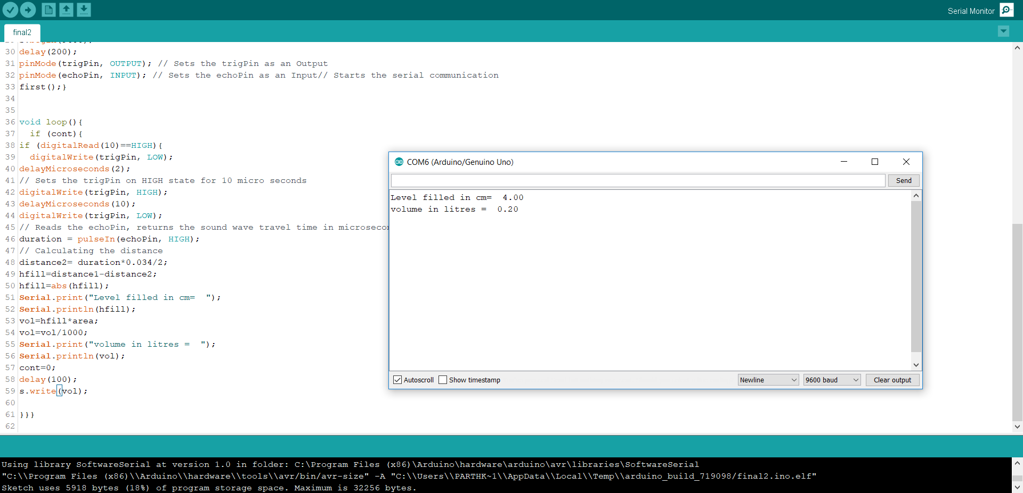
Hardware does the job of taking actual readings for the fuel and acting as an interface between the server and real world handling data for further analysis to the server.

Slide 6

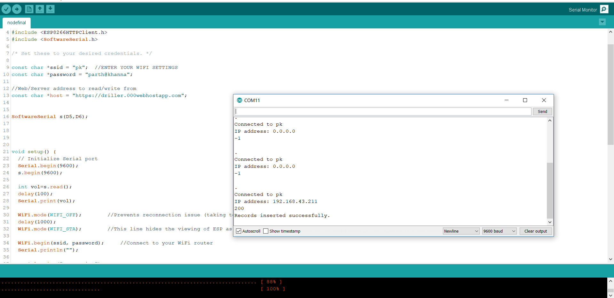
The technology:
GPS + RFID

Slide 7
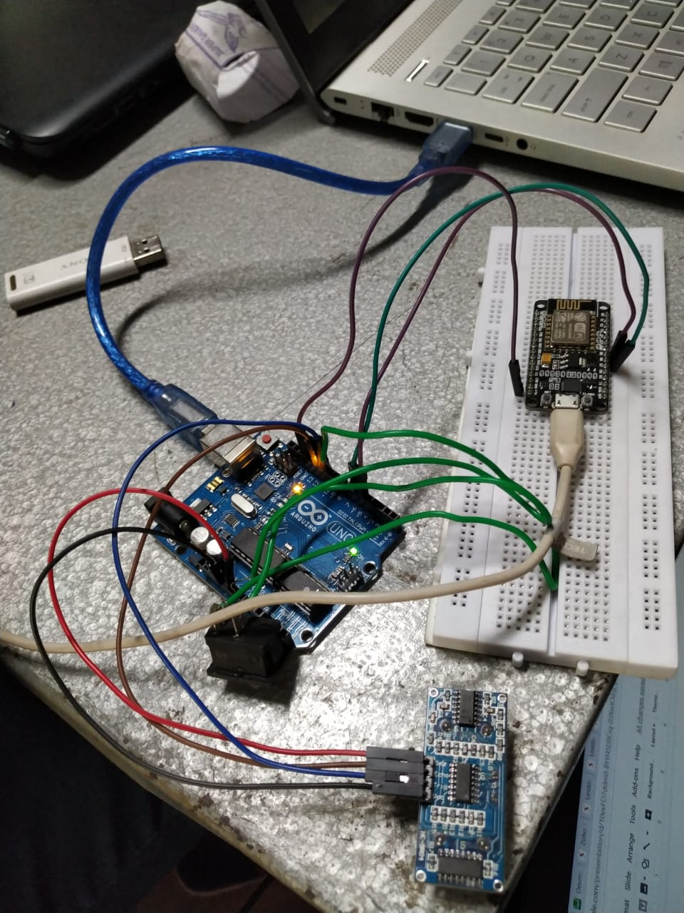

Slide 8
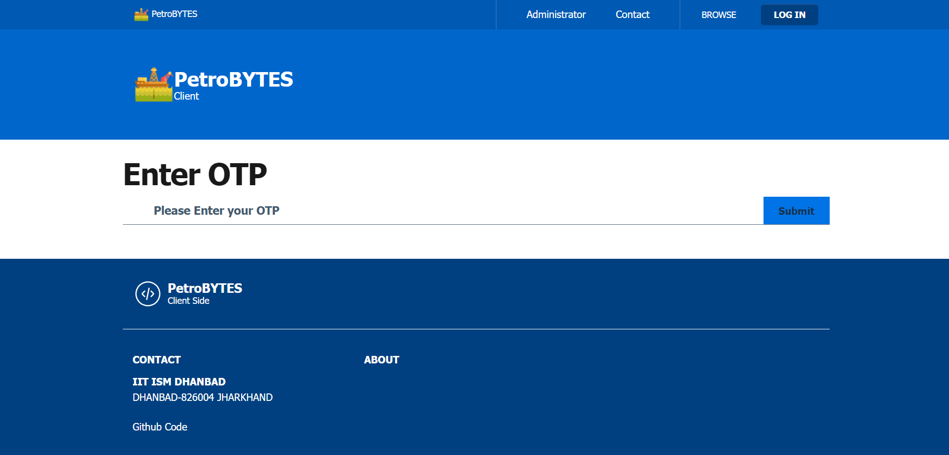

Slide 9
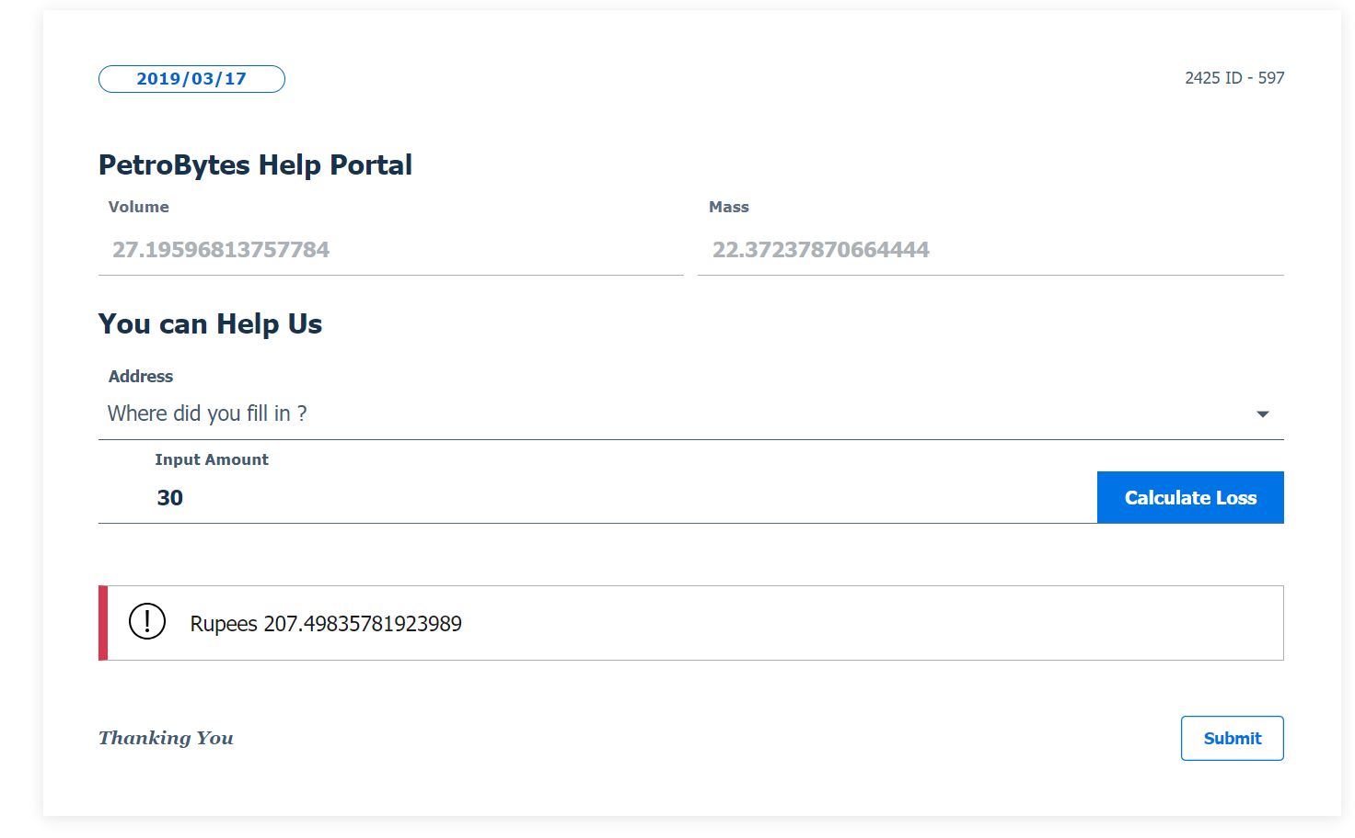

Slide 10
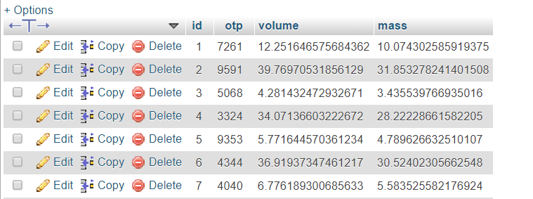
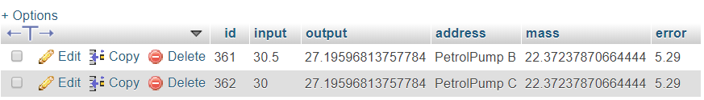
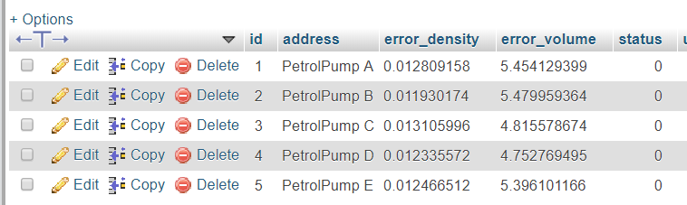
Data Tables

Slide 11
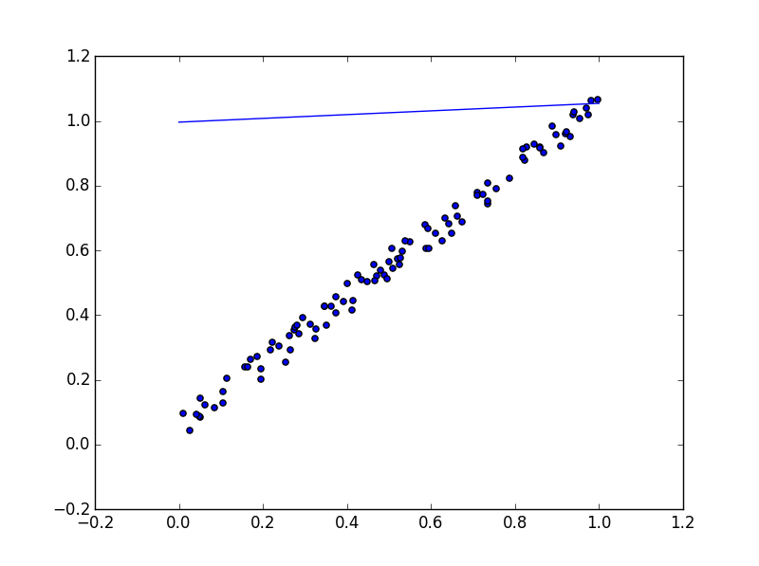
LINEAR REGRESSION
X2------->
X1------>

Slide 12
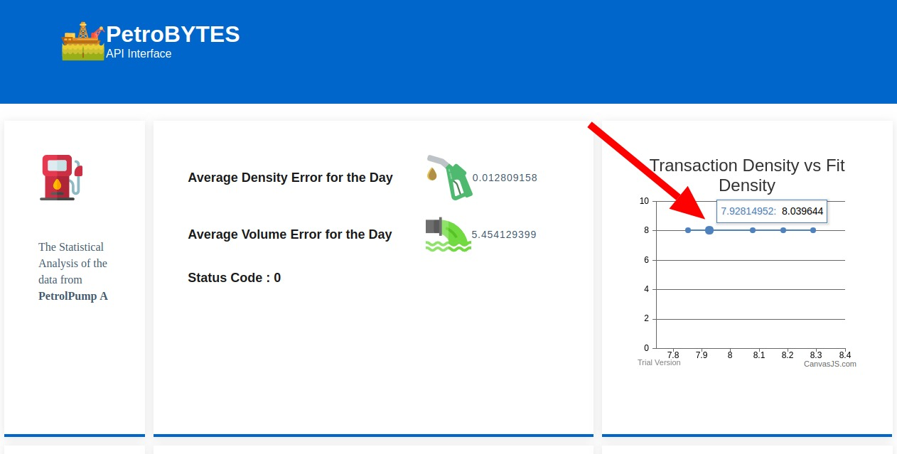
Administrator View

Slide 13

Future Plans
Shift this entire technology to a blockchain so that this system becomes immutable

